Slide 1

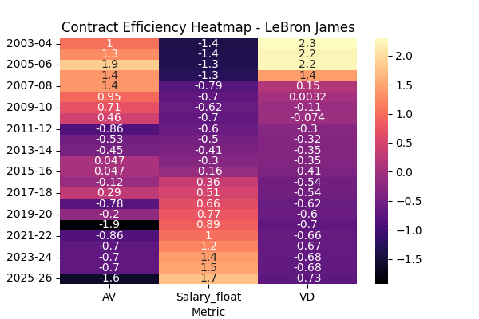
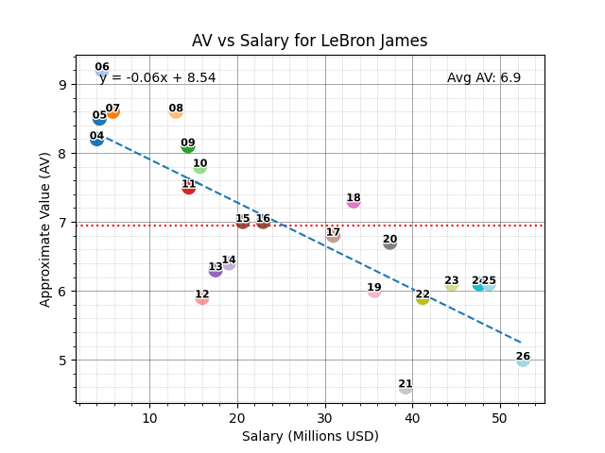
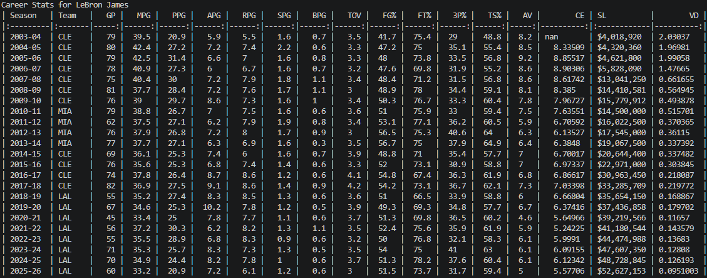
NBA Stats Analysis
By: Salman Khalid
GitHub Repo: https://github.com/ksu-is/NBA_Stat_Analysis
Quantifying player value beyond the box score
This program taps into NBA player stats via an API and combines them with salary data from Basketball Reference to uncover hidden insights into player performance.
By leveraging Approximate Value (AV), it creates a powerful custom metric, Value per Dollar (VD), that evaluates player efficiency in relation to their contracts, providing a fresh perspective on player value.

